Slide 1
TT231 – GitLab Internal Training
24 June 2019

Slide 2
Agenda
Key things in Git
TT231 GitLab Project
Repository Management
Coding Flow
GitLab Tools

Slide 3
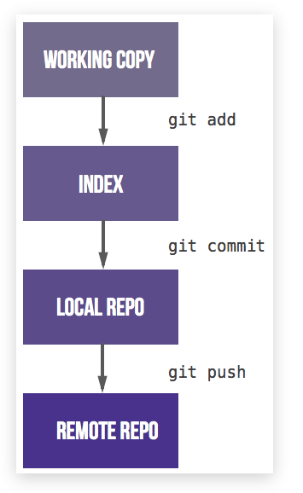
Key things in Git
Unlike SVN, Git consist of “Local Repo” and “Remote Repo”
Most important commands in GIT:
“Fetch”:
downloads commits, files, and refs from a remote repository into your local repo.
Fetching is what you do when you want to see what everybody else has been working on.
“Pull”:
The git pull command is used to fetch and download content from a remote repository and immediately update the local repository to match that content.
Merging remote upstream changes into your local repository is a common task in Git-based collaboration work flows.

Slide 4
Key things in Git
Unlike SVN, Git consist of “Local Repo” and “Remote Repo”
Most important commands in GIT:
“Push”:
The git push command is used to upload local repository content to a remote repository.
Pushing is how you transfer commits from your local repository to a remote repo.
“Commit”
The git commit command captures a snapshot of the project's currently staged changes.
Committed snapshots can be thought of as “safe” versions of a project
“Merge Request”
To raise a merging code from a branch to another branch

Slide 5
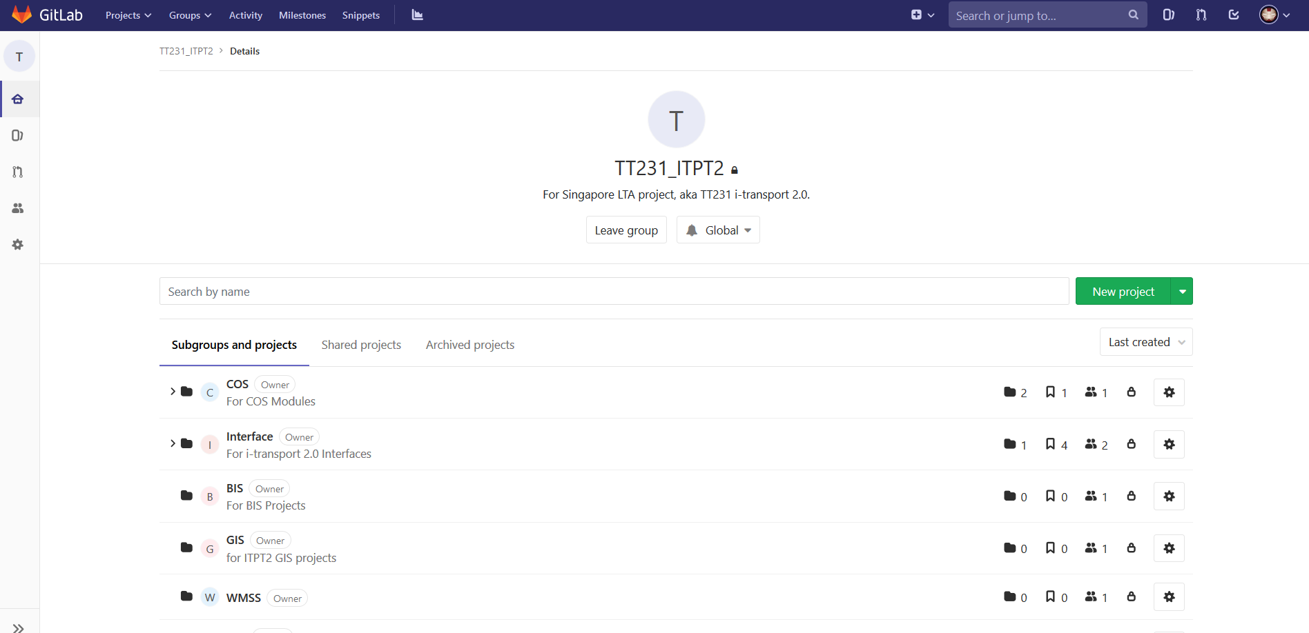
TT231 GitLab Project

Slide 6
Repository Management
5 type of Branches
Master (Permanent)
ALWAYS Production Code
Only check in from Release
Release (Permanent)
For developers to work together and consolidating all the code before release
Code stay here before deployed to production (then merge into Master)
Development (Permanent)
For developers to work together on all the unreleased changes/features
Features
A features per branch
To be removed after merge into development
Can only merge into Development
Prefix of “feature_”
Hotfixes
A fixes per branch
For issues that required faster/immediate solution to production / testing
Can only merge into Development
Prefix of “hotfix_”

Slide 7
Coding Flow
Local Changes
Commit
Push
Raise merge request
Ok?
Prepare for Release
master
V1.0.2
release
development
feature_mainpage
feature_websocket_dev
Check in EVERYDAY before you leave (commit & push to remote git server)

Slide 8
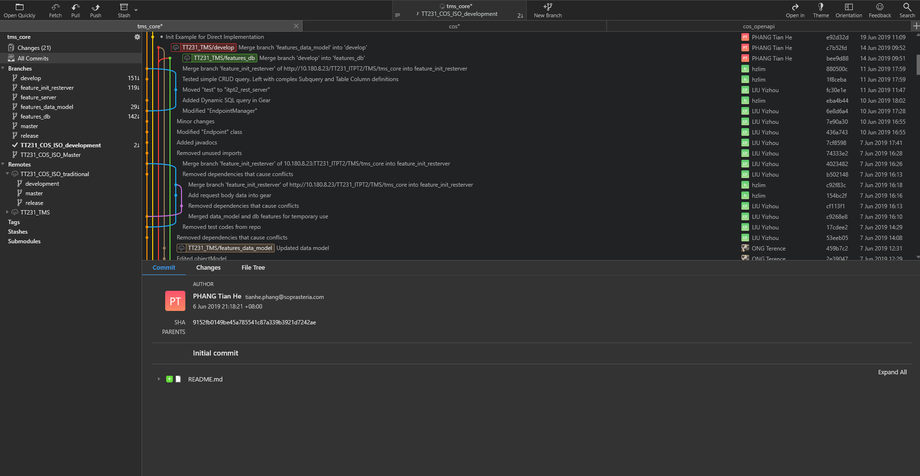
GitLab Tool
Eclipse (Plugin available)
Fork (Free Windows GUI GitLab tool)

Slide 9
End
Confidential

